Slide 1

OUTER SPACE JUSTICE
F. E. Guerra-Pujol
LatCrit 2023 Biennial Conference
7 October 2023

Slide 2
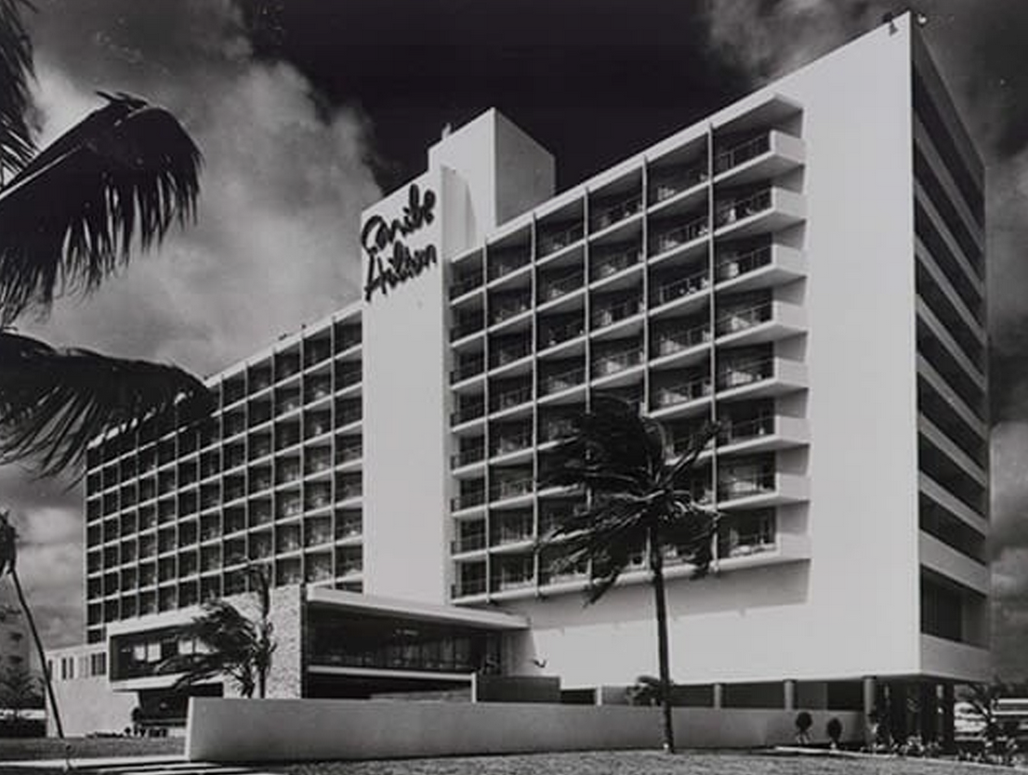
Preface: I attended my first LatCrit Conference twenty years ago in San Juan, Puerto Rico!
Notes:
Although I don’t remember what work I presented, what really matters are the lifelong friends I made.

Slide 3
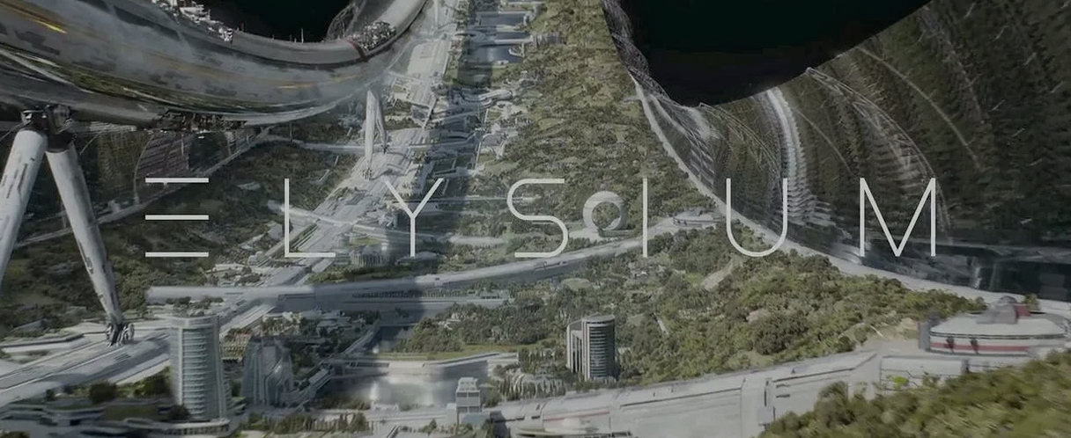
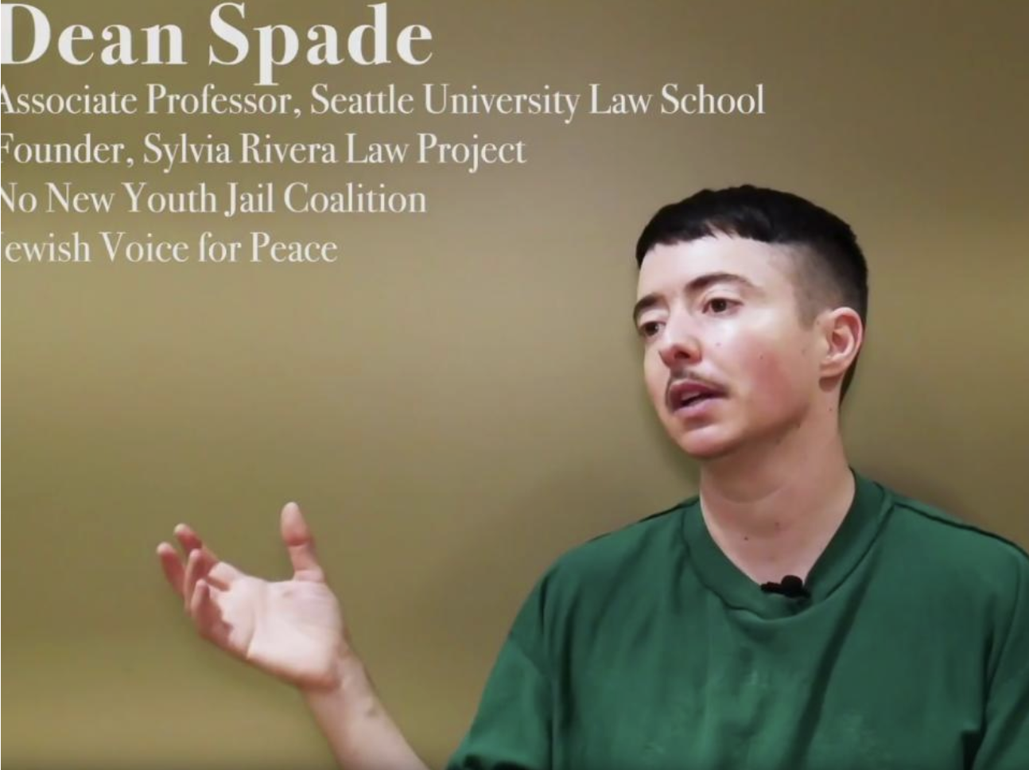
Premise of the 2013 movie Elysium: The year is 2154, and life on Earth is now riddled with disease and overpopulation. Earth’s most wealthiest and privileged citizens, however, are able to leave Earth and now live on the ultra-luxurious space station called Elysium: a place where poverty doesn’t exist and life-threatening diseases and aliments can be cured in a matter of minutes.
Notes:
https://en.wikipedia.org/wiki/Elysium_(film)

Slide 4

Notes:
https://www.spacex.com/human-spaceflight/mars/

Slide 5


Does “Gödel’s Loophole” extend
to “The Constitution of Mars”?
Notes:
https://papers.ssrn.com/sol3/papers.cfm?abstract_id=4519241

